Slide 1
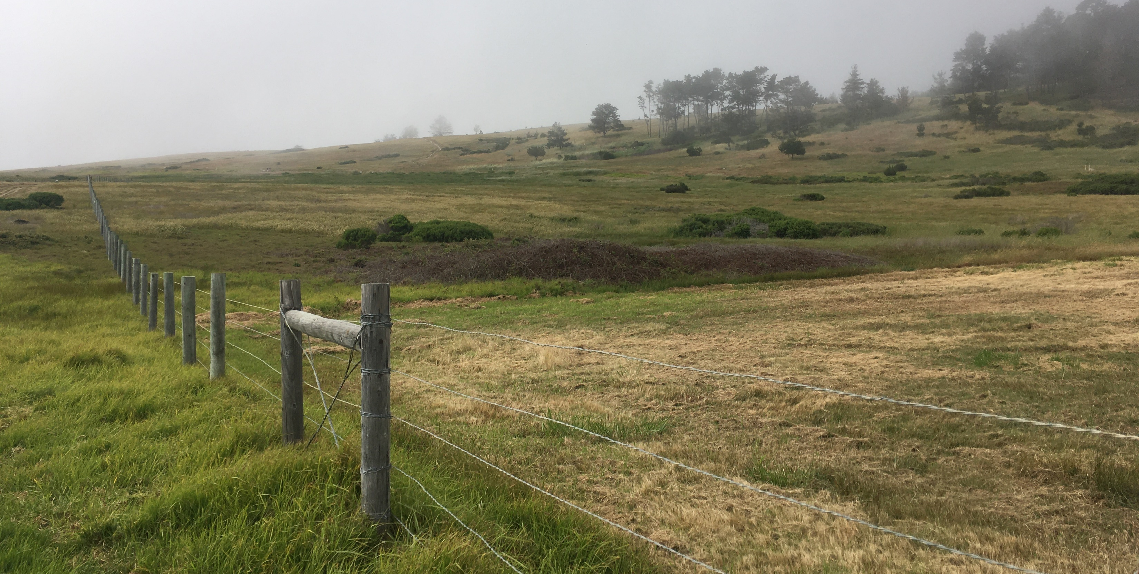
Area for the new boardwalk trail, by Friends of the Fiscalini Ranch Preserve
By KITTY CONNOLLY, Executive Director, Friends of the Fiscalini Ranch Preserve (fiscaliniranchpreserve.org)
While so much in America remains unsettled, or is unsettling, it can bring a sense of order to focus on the good you can do right here in your own community. That is one reason CambriaCA.org exists and why I am pleased to contribute to it on behalf of Friends of the Fiscalini Ranch Preserve. Cambrians are especially involved in their community with untold numbers doing good by volunteering with the Fiscalini Ranch Preserve over the years. Thank you.
Cambria Community Services District owns Fiscalini Ranch Preserve while Friends of the Fiscalini Ranch Preserve holds a conservation easement over the property and serves as a “friends” group providing volunteer and financial support for the management of the property. Our mission is to protect and sustain the diversity of life and the beauty of the Fiscalini Ranch Preserve for everyone. FFRP fulfills its mission through programs in preservation, restoration, recreation, and education.
In 2020 we celebrated 20 years since Fiscalini Ranch Preserve became public open space. In 2021 we look forward to the next 20 years with some major projects in sight.
Public access to the West Ranch for passive recreation is a prime goal for FFRP. After all, the Preserve was founded on the principle of public access. Although there are eight miles of maintained trails on the Ranch, a key connector is missing. While the Marine Terrace (fire road) and Bluff Trails are both accessible to the mobility impaired and meet at their north end, there is no accessible link to complete the loop at the south end. Instead, people have had to leave the Ranch and walk along Wedgewood Drive.
It has long been a dream of FFRP’s board and volunteers to construct a boardwalk trail that runs between the Marine Terrace and Bluff Trails, where now there is a grass path extension of the Meander Trail. Working with the California Conservation Corps, FFRP had begun planning for that trail. Its route will be configured to avoid and protect seasonal wetlands while highlighting views of the spectacular birds that soar over the Ranch. With a gradual grade changes and firm footing, this new boardwalk will be accessible to all. We are currently seeking grants to support this project.
On the restoration front, replanting the Monterey pine forest and removal of invasive species are long standing FFRP programs. In 2020 more than 350 seedlings were added to an already expanded forest while untold thousands of thistle, mustard, and broom plants were removed by tireless volunteers. Over the years, volunteers have gathered and spread seed of annuals and perennials to encourage coastal scrub plants, but a new restoration nursery will allow FFRP to expand our revegetation efforts. In a small shade house, we will propagate plants native to the Ranch for gradual restoration of the forest understory, expansion of coastal bluff scrub habitat, and replacement of invasive grasses with coastal sage scrub vegetation. The restoration nursery will be a fundraising focus in 2021.
As preparation for expanded restoration efforts, two graduate students are conducting research on the Ranch this year. A student from CSU Bakersfield is looking at the impact of ice plant on the establishment of native sand aster while another student from Cal Poly will conduct a survey of forest understory plants. Both studies will inform restoration efforts and help us to know the site better.
Together these projects will enhance the Preserve’s recreation and conservation value and improve the experience for all who visit the Ranch. Happy 2021!
Notes:
.3.
3
.32
2

